Slide 1
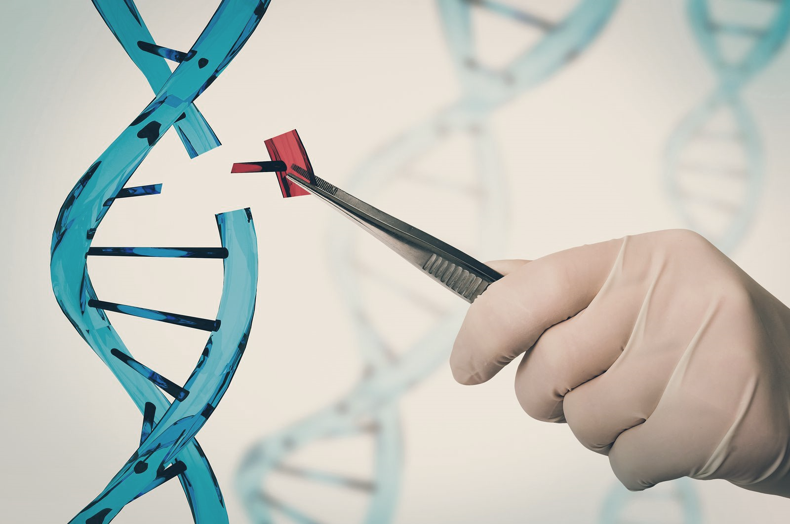
Gene Editing
Student: Isaac Reyna Uresti
Teacher: Enrique Gutierrez Acosta
Group: 11
1923148

Slide 2
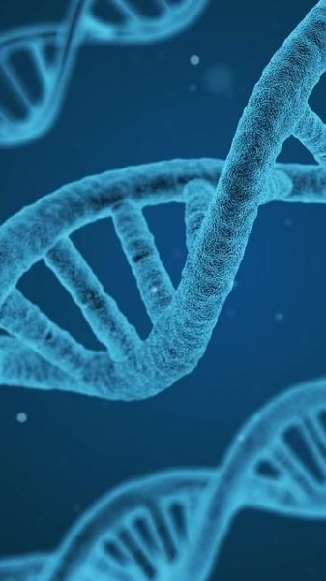
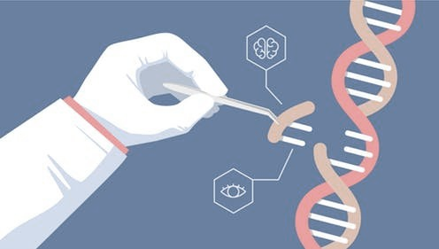
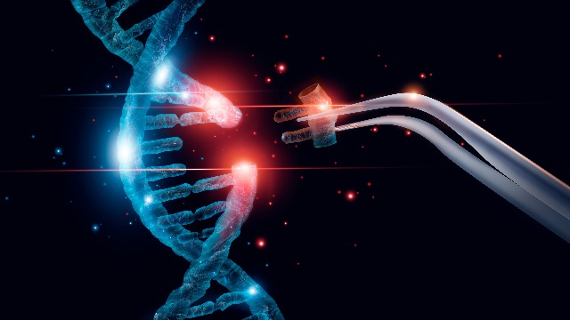
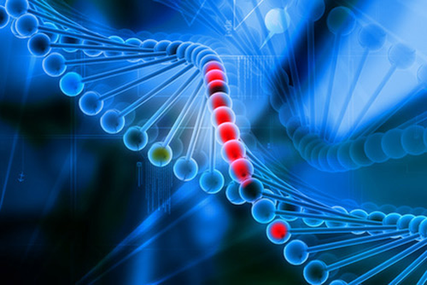
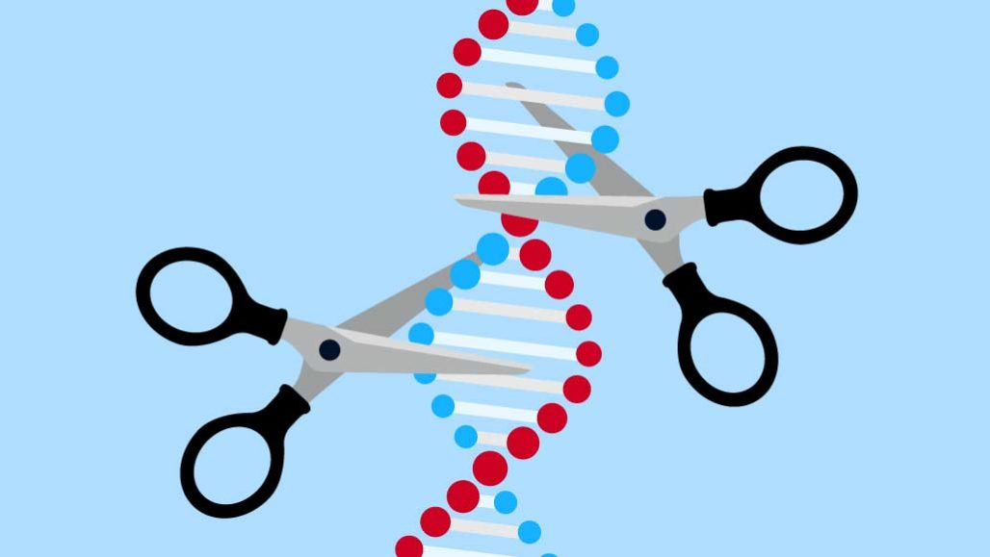
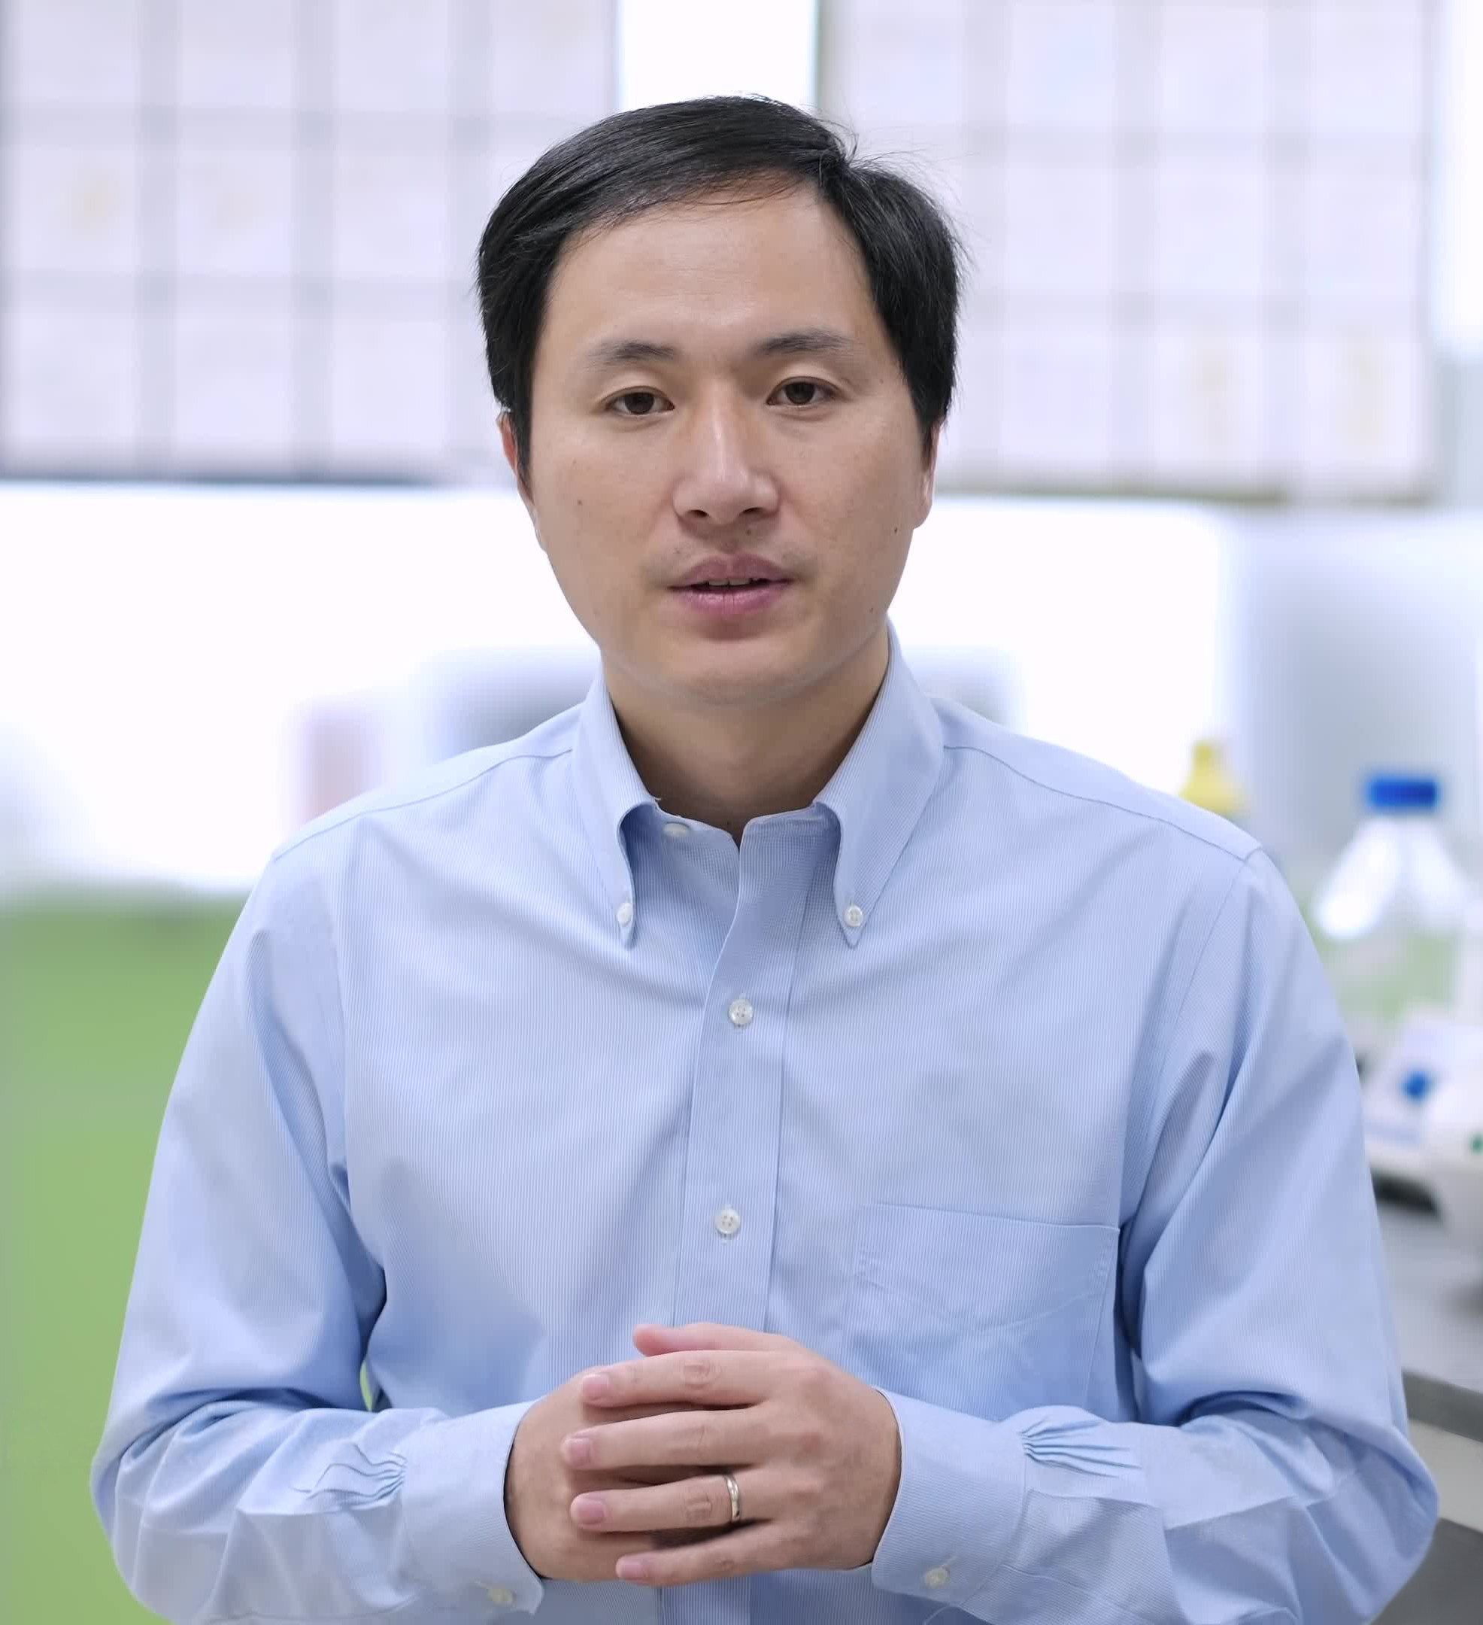
CRISPR
Clustered Regularly Interspaced Short Palindromic Repeats
CRISPR is a genetic editing technique, capable of modifying our genetic code
CRISPR makes it possible to cut specific gene chains and modify them
CRISPR could cure diseases whose genetic cause is known
The specificity of CRISPER RNA is not complete, it is not yet safe to use it in humans
He Jiankui made genetic modifications to 2 twin girls, it is not yet known what consequences this will bring

Slide 3
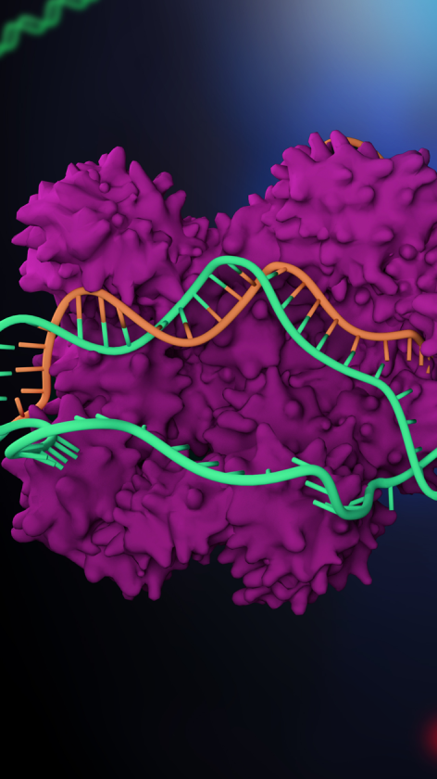
Conclusion
CRISP is a technique that opens many doors for us, although, as always, scientific progress must go hand in hand with the ethical debate on it. With great power comes great responsibility. There is an urgent need to establish a solid legal basis that defines the limits of this promising technique that is CRISPR

Slide 4
Bibliography
https://www.youtube.com/watch?v=xYiU-8End8w
https://www.youtube.com/watch?v=UaxrYWCyLdY&t=676s
https://www.dciencia.es/que-es-la-tecnologia-crispr-cas9/
https://www.agenciasinc.es/Reportajes/El-editor-genetico-CRISPR-explicado-para-principiantes

